Slide 1

Stock Prediction NIVDIA
Apple
Ben
Simon
20241118 Stock Prediction NIVDIA

Slide 2
Motivation
Why NVIDIA?
NVIDIA's pivotal role in AI and high-performance computing.
The impact of stock price fluctuations on Tech. companies.
Leveraging ML for improved price prediction accuracy.
Objective:
Evaluate the effectiveness of ML methods in predicting
NVIDIA stock price fluctuations.
Stock Prediction NIVDIA

Slide 3
How to do
Data Source
NVIDIA historical stock data (Jan. 2010 – Sep. 2024)
Split the data (70% for training, 30% for testing)
Source: Bloomberg
Key Features
High, low, open, and close prices
Trade volume, volatility, and technical indicators (ex: RSI, MACD)
Stock Prediction NIVDIA

Slide 4
How to do
Models
Logistic Regression: Simple and interpretable
Random Forest: Robust for high-dimensional data
XGBoost: Powerful boosting algorithm, refines predictions by correcting errors from prior iterations.
Stock Prediction NIVDIA

Slide 5
How to do
Research Workflow
Data cleaning and handling missing values
Feature engineering and model training (testing three models)
Results evaluation: Comparing accuracy to the NDX Index
Simulating an investment strategy
Stock Prediction NIVDIA

Slide 6
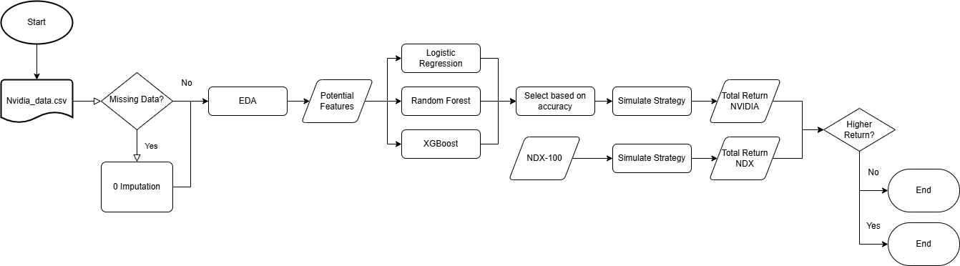
How to do
Flow chart
Stock Prediction NIVDIA

Slide 7
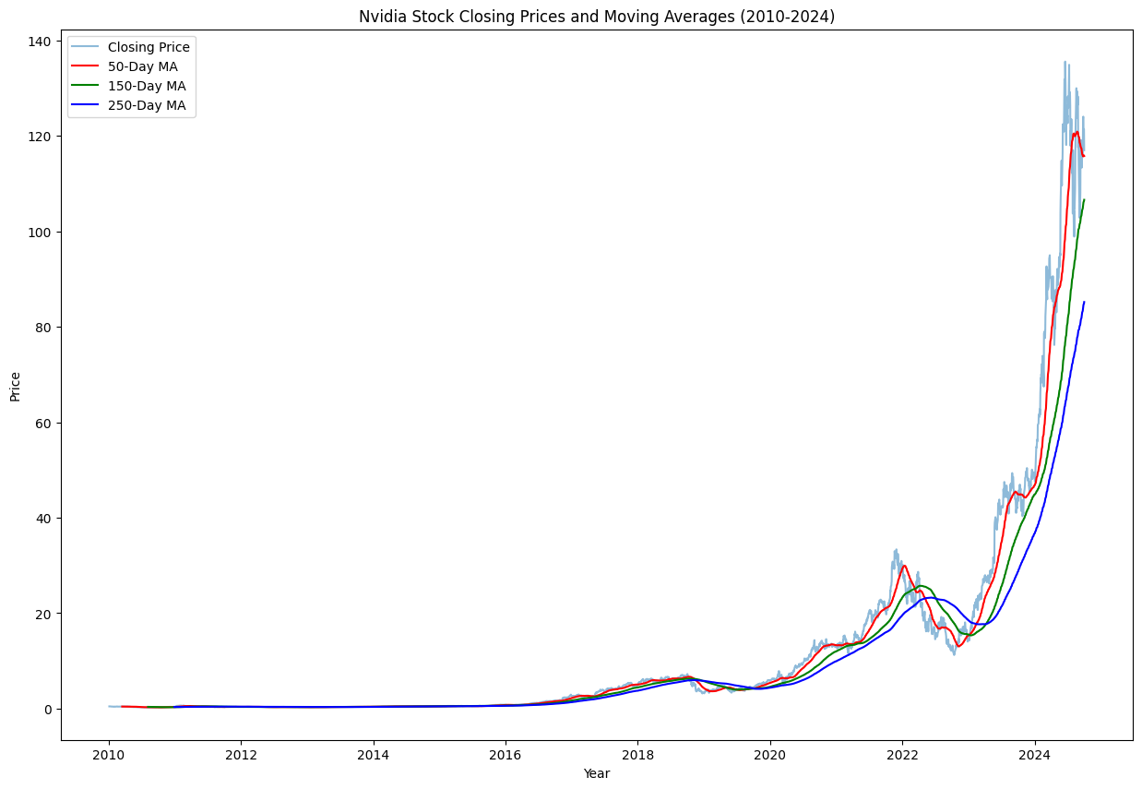
Stock Prediction NIVDIA

Slide 8
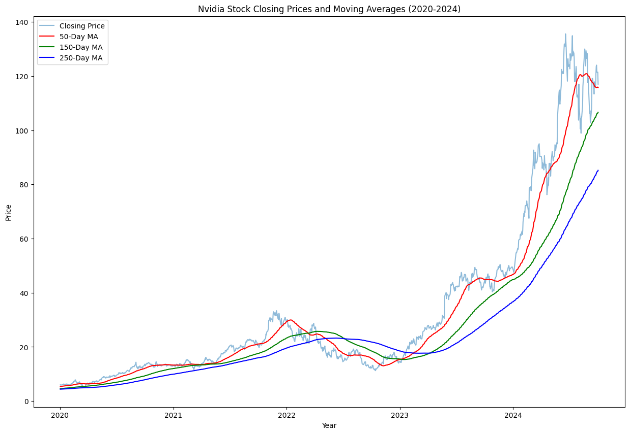
Stock Prediction NIVDIA

Slide 9
Motivation
How to do
Accuracy of Models
Logistic Regression: 53.4%
Random Forest: 45.6% < 50%
XGBoost: 50%
Stock Prediction NIVDIA

Slide 10
Motivation
How to do
Initial Balance | $10000
Final Balance | $198716.37
Total Return | 1887.16%
Trading period | From 2020-04-29 to 2024-10-01
Total number of trades executed | 301
Stock Prediction NIVDIA

Slide 11
Section Title
Goal
Improve feature selection and hyperparameter tuning
Explore external factors affecting predictions
Extend to other technology company stock predictions
Stock Prediction NIVDIA

Slide 12
Stock Prediction NIVDIA
Apple
Ben
Simon
20241118 Stock Prediction NIVDIA

